Slide 1
Introduction to Automation
Copyright 2023 UiPath

Slide 2
On your marks, get set, go!

Slide 3

Course agenda
01
05
How can automation fit into my business?
What is automation?
02
06
How do I identify automation opportunities?
How can automation help me?
03
07
Configure your first automation
Check your knowledge
04
08
How do I team up with a robot?
Learning resources
Notes:
Facilitator notes:
Inform the participants briefly about the course agenda.

Slide 4

Course objectives
At the end of this course, you should be able to:
01
Describe automation fundamentals, including UiPath automation models, and effectively share the benefits with colleagues across departments.
02
Create a simple automation project in Studio Web using templates.
Describe different collaborative scenarios between humans and robots in an automated enterprise, as well as the roles that support the automation journey and the roles you can take in this context.
03
04
Assess the applicability of automation for personal tasks and identify potential tasks/processes from daily work that can be automated.
Notes:
Facilitator notes:
Briefly explain the learning objectives of this course and the expectations from the participants by the end of the course. It may not be required for you to go into details at this point. Explain your role as the facilitator in ensuring that all participants are able to meet or exceed these expectations following this training and emphasize your availability to those who may need further assistance after the training concludes.

Slide 5
01
What is automation?

Slide 6
Lesson objectives
At the end of this lesson, you should be able to:
01
Explain what automation is and its benefits.
02
Differentiate between the various automation categories UiPath offers its users.
Notes:
Facilitator notes:
Briefly explain the learning objectives of this lesson.

Slide 7
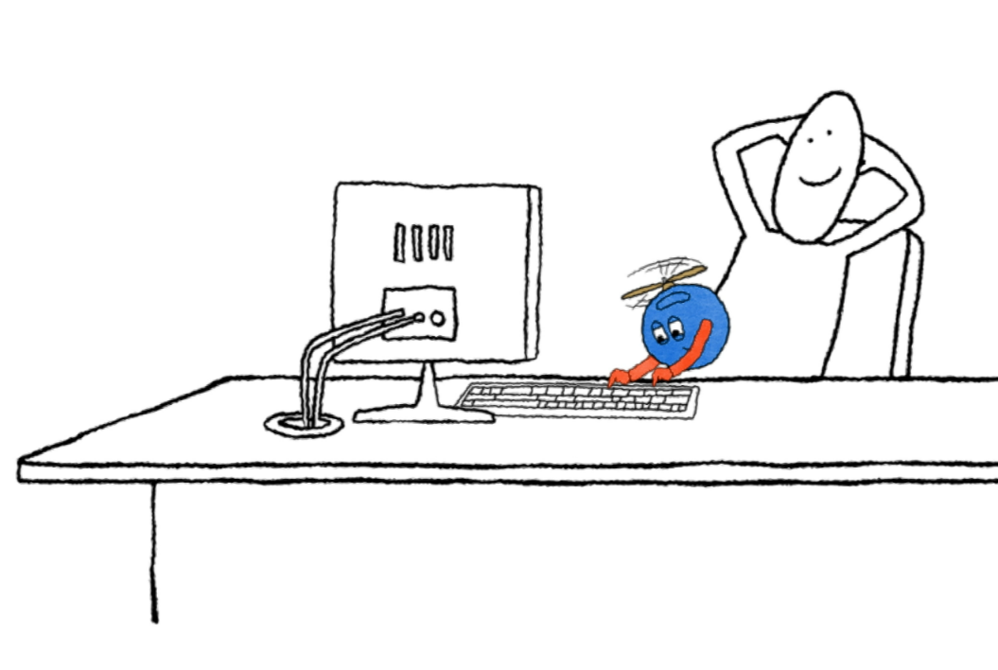

Activity time!
Name one day-to-day process that has made your life easier since it was automated.
  Hints:
  Automatic payments
  Automatic door locks
  Automatic elevators
Notes:
Facilitator notes:
Ask the activity question and encourage participation. You can point to the hints on the slide as examples.

Slide 8



Automation…
Frees us to focus on essential work
Eliminates repetitive tasks
Leads us to more productive lives
Notes:
Facilitator notes:
Provide a brief introduction of the lesson to the participants. Give some examples of automation to help illustrate the concept. The example of the washing machine is just a sample. You can use other examples to provide context as well.
Detailed notes:
People once washed clothes by hand, a tedious and tiring task. Today, washing machines simplify this process with a button, providing more time for family, hobbies, and other enjoyable activities. We can parallel washing machines with the automation's ability to improve the quality of our lives. It eliminates repetitive tasks, freeing us to focus on essential work and lead more productive lives.

Slide 9

What is automation?
It involves leveraging technology, software, or machinery to carry out tasks.
It minimizes or eliminates the need for constant human intervention.
It allows processes to run smoothly and efficiently.
Notes:
Facilitator notes:
Briefly explain what automation is and its benefits to the participants.
Detailed notes:
Automation, in its essence, involves leveraging technology, software, or machinery to carry out tasks that would typically require human effort. The beauty of automation lies in its ability to minimize or eliminate the need for constant human intervention, allowing processes to run smoothly and efficiently.

Slide 10
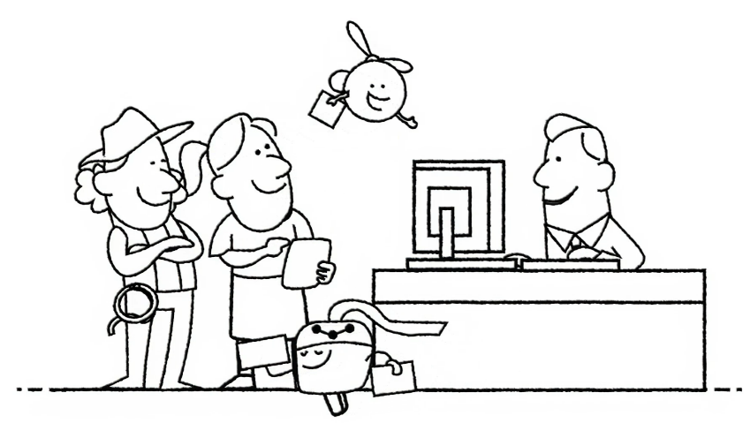
Why is automation such a game-changer?
It revolutionizes the way businesses and individuals operate.
It takes over repetitive tasks allowing employees to focus on more strategic and creative responsibilities,
leading to higher
job satisfaction.
It leads to increased efficiency and improved accuracy by reducing
human errors and streamlining processes.
It allows organizations to cut costs, enhance scalability, and provide 24x7 operations..
Notes:
Facilitator notes:
Begin by explaining why automation is a game-changer. Emphasize that automation helps to improve efficiency and accuracy, and ultimately increase productivity.
Detailed notes:
Why is automation such a game-changer? Automation revolutionizes the way businesses and individuals operate. It leads to increased efficiency and improved accuracy by reducing human errors and streamlining processes. Automation allows organizations to cut costs, enhance scalability, and provide 24x7 operations. By automating repetitive tasks, employees can focus on more strategic and creative responsibilities, leading to higher job satisfaction.
It's like having a reliable digital assistant that takes care of the mundane, allowing you to channel your energy and expertise where it matters most.

Slide 11

The story of work
Work has evolved throughout history, with people constantly improving their productivity using various tools and gadgets.
Notes:
Facilitator notes:
Play the video and briefly explain the evolution of work to the participants.
Detailed notes:
Let's rewind and uncover the origins of automation. Work has evolved throughout history, with people constantly improving their productivity using various tools and gadgets. However, to be honest, work can still feel tedious at times.
With robots, we find ourselves at a remarkable crossroads in the history of work. Robots eliminate repetitive tasks, increase efficiency, and more than anything, allow people to focus on the important stuff, while they take over the boring and repetitive ones.
Video: <video link>

Slide 12
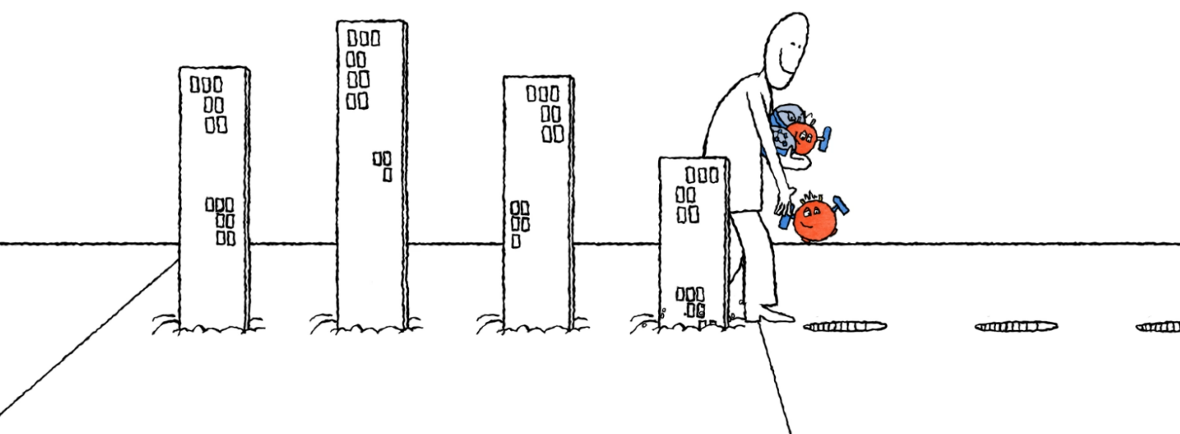
UiPath: where it began
With the advent of computers and technology, the need for software robots emerged, leading to the founding of UiPath in 2005.
UiPath now serves global customers and offers a range of capabilities to transform the way we work.
Notes:
Facilitator notes:
Provide an overview of how UiPath was established.
Detailed notes:
From their humble beginnings, as modern marvels utilized in manufacturing and space exploration, robots have come a long way. With the advent of computers and technology, the need for software robots emerged, leading to the founding of UiPath in 2005.
As a major player in the automation industry, UiPath serves global customers and offers a range of capabilities to transform the way we work. Let’s learn more about what UiPath does and what their capabilities are.

Slide 13

Automation categories
With UiPath, there are a bunch of automation categories that can help you get things done faster and easier!
Robotic Process Automation (RPA)
Test Automation
Task Automation
AI and Machine Learning Integration
Business Process Automation
Process Mining and Discovery
Notes:
Facilitator notes:
List the different automation categories that UiPath offers and explain each of them in detail to the participants.
Detailed notes:
With UiPath, there are a bunch of automation categories that can help you get things done faster and easier!
Robotic Process Automation (RPA): Through Robotic Process Automation (RPA), the creation of software robots that mimic human actions and effortlessly engage with digital systems becomes possible. RPA enables organizations to automate tasks across a diverse range of applications and systems, including legacy systems, web applications, and desktop applications.
Task Automation: Task automation targets repetitive and mundane tasks such as data entry, data extraction, file management, and document processing. By automating these routine activities, you not only save valuable time and resources but also minimize the risk of errors, allowing you to dedicate your focus to the most critical tasks.
Business Process Automation: UiPath empowers organizations to automate entire business processes by seamlessly connecting multiple tasks and systems. By implementing UiPath, your department or team can experience streamlined workflows, enhanced operational efficiency, and consistent execution of processes.
Test Automation: With Test Automation, organizations can automate the testing of their applications and systems, revolutionizing software quality. Automated testing speeds up release cycles and reduces the time and effort spent on manual testing.
AI and Machine Learning Integration: By integrating automation with AI and machine learning services, users can incorporate intelligent automation into their workflows. This includes leveraging natural language processing, digital image processing, and predictive analytics.
Process Mining and Discovery: Process mining and discovery tools, empower organizations to identify and analyze their existing processes. This valuable insight leads organizations to the most promising opportunities for automation, enabling them to scale up their automation initiatives and prioritize projects with the greatest impact.

Slide 14

Playback time!
Automation transforms work by using robots to tackle repetitive tasks, allowing us to concentrate on high-value activities.
With UiPath, you can deploy robots that automate daily tasks, organizational processes, and app testing.
Enhance automation by integrating AI capabilities like language models and image processing.
Leverage process mining tools to extract insights from data, enabling better informed decision-making.
Notes:
Facilitator notes:
Summarize the points.
Detailed notes:
Recalling the key points!
Automation transforms work by using robots to tackle repetitive tasks, allowing us to concentrate on high-value activities.
With UiPath, you can deploy robots that automate daily tasks, organizational processes, and app testing.
Enhance automation by integrating AI capabilities like language models and image processing.
Leverage UiPath's process mining tools to extract insights from data, enabling better informed decision-making.

Slide 15

Check your knowledge
1/1
Match the automation type with the most specific corresponding benefit.
Test Automation
Automates routine tasks like data entry
Task Automation
Automates testing of applications and systems
Process Discovery Tools
Integrates AI into workflows
AI and Machine Learning Integration
Identifies automation opportunities in processes
Robotic Process Automation (RPA)
Creates software robots mimicking human actions
Notes:
Facilitator notes:
Ask the question and encourage participation.
After the participants get a chance to give their answers, click the slide to reveal the answer.

Slide 16
Check your knowledge
1/1
Match the automation type with the most specific corresponding benefit.
Test Automation
Automates testing of applications and systems
Task Automation
Automates routine tasks like data entry
Process Discovery Tools
Identifies automation opportunities in processes
AI and Machine Learning Integration
Integrates AI into workflows
Robotic Process Automation (RPA)
Creates software robots mimicking human actions
Notes:
Understanding these different categories of automation will help you leverage the capabilities of UiPath effectively.

Slide 17
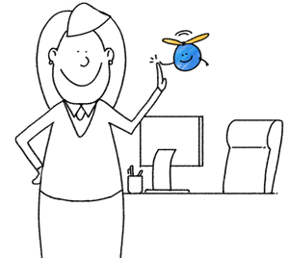
Automation is an invaluable asset with great benefits. In the next lesson, we'll reveal 10 powerful reasons to adopt automation, showcasing the impact on individuals and businesses.
Let’s dive in!
Notes:
Facilitator notes:
Provide a gist of what will be covered in the next lesson before opening the classroom for discussions.

Slide 18
Discussion
Notes:
Facilitator notes:
Open up the classroom for discussions on what was covered so far. You can also check with the class if they have any questions on what was discussed so far. Use the time to share any relevant work experiences regarding the topic.

Slide 19
02
How can automation help me?

Slide 20
Lesson objectives
At the end of this lesson, you should be able to:
01
List the different ways in which you can leverage automation.
02
Describe the benefits of automation for you and your business.
Notes:
Facilitator notes:
Briefly explain the learning objectives of this lesson.
Detailed notes:
At the end of this lesson, you should be able to:
List the different ways in which you can leverage automation.
Describe the benefits of automation for you and your business.

Slide 21
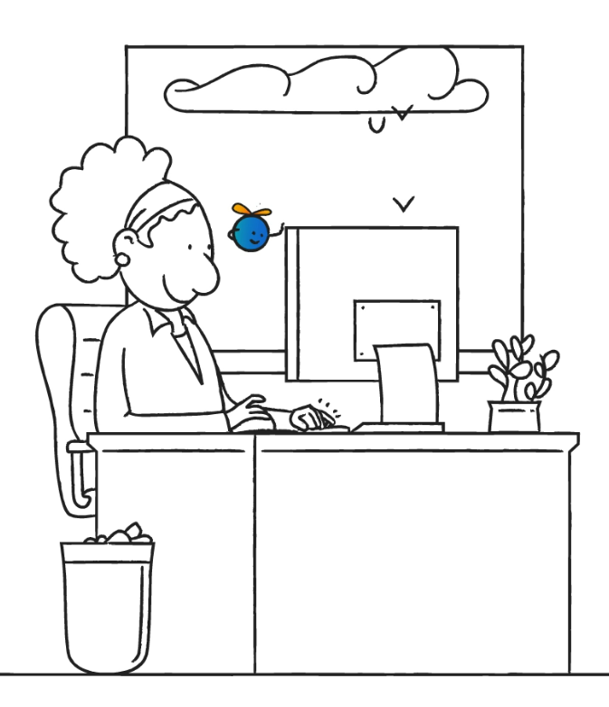
Overview
How can automation make my work easier and more efficient?
What can automation do for me?
Notes:
Facilitator notes:
Provide a brief introduction of the lesson to the participants.
Detailed notes:
In the previous lesson, we introduced you to automation and its different categories. But have you wondered what it can do for you? How can automation make your work a lot easier and more efficient? Or maybe you're still unsure if automation can work in your organization and domain.
Well, you'll find all your answers and more in this lesson!

Slide 22
How can automation help me?
Here are four compelling reasons why automation can be a game-changer for your work life.
Job satisfaction
Enhanced opportunities
Skill development
Reduced stress
Notes:
Facilitator notes:
Explain the reasons why automation can be a game-changer in people’s work lives.
Detailed notes:
Here are four compelling reasons why automation can be a game-changer for your work life.
Job satisfaction: By automating repetitive tasks, you not only escape the burnout and boredom cycle but also gain precious time to dedicate to more engaging and fulfilling work.
Skill development: With automation handling mundane tasks, you have the perfect opportunity to embrace personal growth, learn new skills, and embrace higher-value roles within your organization.
Enhanced opportunities: Embracing automation and related technologies can greatly enhance your value in the job market, opening doors to exciting career opportunities and unlocking new pathways for professional growth.
Reduced stress: Letting automation handle mundane tasks gives you the freedom to embrace a healthier work-life balance, experiencing reduced stress and more time for what truly matters.

Slide 23
How can automation help my organization?
Here are six main reasons for your organization to embrace automation.
Saved cost
Enhanced compliance
Improved accuracy
Improved scalability
Increased efficiency
Optimized resource allocation
Notes:
Facilitator notes:
Explain the reasons why every organization should embrace automation.
Detailed notes:
Here are six main reasons for your organization to embrace automation.
Saved cost: Automation brings valuable benefits to businesses by reducing labor costs and enabling teams to allocate their time and resources to more strategic and high-value activities.
Improved accuracy: With software robots, businesses can significantly reduce errors. This results in the generation of high-quality data, enabling informed decision-making and driving substantial improvements in overall business performance.
Increased efficiency: Robots excel at lightning-fast task execution, resulting in quicker turnaround times and enhanced output.
Enhanced compliance: By implementing standardized processes and generating automated audit trails, automation not only ensures adherence to regulations and internal policies but also offers a sigh of relief for your organization.
Improved scalability: One of the most impressive aspects of automation is its remarkable scalability, allowing organizations to effortlessly adapt to fluctuations in demand and navigate business needs with ease.
Optimized resource allocation: Having their routine tasks automated, employees can focus on strategic, creative, and customer-centric endeavors. This unlocks higher productivity and fosters a culture of innovation, driving business success.

Slide 24






Common automation use cases
Let's explore six common examples of how automation can greatly benefit your work.
Payroll
processing
Client information
update
Contract
renewal
process
Financial
statement
reconciliation
Compliance
reporting
Customer
complaint
processing
Notes:
Facilitator notes:
List the six common automation use cases to the participants.
Detailed notes:
Automation has the power to tackle a wide array of repetitive tasks performed on computers, making it applicable across diverse industries.
To get a better grasp of how automation can help, let's look at some examples that are common in so many businesses.

Slide 25



Common automation use cases: payroll processing
Before
After
Extract details from handwritten
time sheets
Extracts details from handwritten
time sheets
Calculate pay from contracts
Calculates pay from contracts
Initiate the payment transaction
Initiates the payment transaction
Task Completed
Task Completed
Notes:
Facilitator notes:
Describe the challenges of payroll processing and discuss how robots have made it easier.
Detailed notes:
Payroll processing refers to the actions that companies take to pay their employees—keeping track of their presence, of their salaries, bonuses, and taxes.
Payroll processing needs manual intervention month after month, every year. Automation technologies can extract the details that are required from handwritten time sheets. Further, they can calculate the pay from their stipulated contracts—and pay them as well (by even ordering the necessary bank transactions).

Slide 26
Common automation use cases: client information update
Before
After
Update information from
various sources
Processes requests for information
in batches
Make frequent calls to the back-end databases to collect information
Extracts information from the back-end databases
Task Completed
Task Completed
Notes:
Facilitator notes:
Describe the challenges of client information updates and discuss how robots have made it easier.
Detailed notes:
Moving on to the Client Information Update example. It is a fact that any organization that implements a CRM can face all sorts of related issues. One could be the client-base spread across many geographies. There are frequent calls to the back-end databases, and updates are coming from all sources.
Automation solutions can process these requests in batches instead of one after the other. This reduces the load on the back-end systems guaranteeing better performance and data quality across the whole application.

Slide 27
Common automation use cases: contract renewal process
Before
After
Communicate with the client
Communicates with the client
Process the changes from the client
Processes the changes from the client
Draft the required documents
Drafts the required documents
Update the changes in
internal systems
Updates the changes in
internal systems
Task Completed
Task Completed
Notes:
Facilitator notes:
Describe the challenges of the contract renewal process and discuss how robots have made it easier.
Detailed notes:
Contract renewal process is in general a complex process, irrespective of the industry. Not necessarily due to expectations and complications, but because of the number of operations and the synchronization between different departments and systems. Robots can handle the entire process. Starting with standardized communication with the client, processing the changes, drafting the documents, and updating the internal systems accordingly.

Slide 28

Common automation use cases: financial statement reconciliation
Before
After
Matches order, payment, losses, margins with accounts and
financial statements
Match order, payment, losses, margins with accounts and
financial statements
Records discrepancies, if any.
Record discrepancies if any.
Asks for human validation, if required.
Task Completed
Task Completed
Notes:
Facilitator notes:
Describe the challenges of the financial statement reconciliation process and discuss how robots have made it easier.
Detailed notes:
The Financial Statement Reconciliation is a complex process as well. Accounting teams and finance departments spend a lot of time matching orders, payments, losses, margins, and so on, with accounts and financial statements. It’s a common process that an organization needs to manage to ensure clean records and reliable financial documents. This process is easily handled by automation software robots. Once set up, they can carry out all the tasks involved, from the beginning to the end. When needed, they can ask for human validation.

Slide 29
Common Automation Use Cases: Compliance Reporting
Before
After
Monitors the requirements for
each department
Monitor the requirements for
each department
Follows the internal procedure and audit requirements
Follow the internal procedure and audit requirements
Follow-ups on the reporting
to authorities.
Follow up the reporting to authorities
Asks for human validation, if required.
Task Completed
Task Completed
Notes:
Facilitator notes:
Describe the challenges of compliance reporting and discuss how robots have made it easier.
Detailed notes:
As organizations grow, it becomes increasingly difficult to closely monitor the compliance requirements that each department must follow reporting to the authorities, following internal procedures, audit requirements, and so on. Robots can cover all the Compliance Reporting needs, with a low – often zero! – error rate, much more coverage, and low human intervention.

Slide 30
Common automation use cases: customer complaint processing
Before
After
Receive complaint-related calls
from customer
Receives complaint-related calls
from customer
Categorize the customer complaint
Categorizes the customer complaint
Analyze the customer complaint
Analyzes the customer complaint
Suggest practical solutions to
the complaint
Suggests practical solutions to
the complaint
Task Completed
Task Completed
Notes:
Facilitator notes:
Describe the challenges of customer complaint processing and discuss how robots have made it easier.
Detailed notes:
No matter the industry, customer complaints are always on the radar. Their numbers and substance are an important indicator of business health and a good predictor of the future of the company. Automation can quickly categorize customer complaints based on keywords and other criteria and suggest practical solutions to the customers right away. By doing so, customer complaints can be answered 24/7 instead of just eight hours a day, five days a week.
All these examples reflect the benefits and positive impact automation can have on a business and its employees, besides saving valuable time.

Slide 31
Playback time!
Automation can help businesses by improving:
Savings
Accuracy
Efficiency
Salability
Compliance
Resource allocation
Automation can lead to:
Increased job satisfaction
Better opportunities
Better work–life balance
Reduced stress
Notes:
Facilitator notes:
Summarize the points.
Detailed notes:
Recalling the key points!
Automation transforms work by using robots to tackle repetitive tasks, allowing us to concentrate on high-value activities.
With UiPath, you can deploy robots that automate daily tasks, organizational processes, and app testing.
Enhance automation by integrating AI capabilities like language models and image processing.
Leverage UiPath's process mining tools to extract insights from data, enabling better informed decision-making.

Slide 32
Check your knowledge
1/1
A colleague in your department doubts that automation can improve their workflow. Which three of the following use cases could be used as convincing examples to show that automation can be effectively applied to their tasks or processes?
Using automation for repetitive data entry tasks.
Using automation to generate weekly reports.
Using automation to create original and unique copy.
Using automation for routine system backups.
Using automation to negotiate complex contracts.
Notes:
Facilitator notes:
Ask the question and encourage participation.
After the participants get a chance to give their answers, click the slide to reveal the answer.

Slide 33
Check your knowledge
1/1
A colleague in your department doubts that automation can improve their workflow. Which of the following use cases could be used as convincing examples to show that automation can be effectively applied to their tasks or processes?
Using automation for repetitive data entry tasks.
Using automation to generate weekly reports.
Using automation to create original and unique copy.
Using automation for routine system backups.
Using automation to negotiate complex contracts.
Notes:
These tasks are ideal for automation due to their repetitive, rule-based, or time-consuming nature. Automation can efficiently handle data entry, reducing errors and allowing employees to focus on higher-value tasks; streamline report generation by gathering, processing, and presenting data consistently; and manage routine system backups, ensuring data security and redundancy without human intervention.

Slide 34
Automation reduces the need for constant human intervention, but it doesn't leave humans out of the loop entirely.
Now, how about you work on your first attended automation?
Notes:
Facilitator notes:
Provide a gist of what will be covered in the next lesson before opening the classroom for discussions.

Slide 35
Discussion
Notes:
Facilitator notes:
Open up the classroom for discussions on what was covered so far. You can also check with the class if they have any questions on what was discussed so far. Use the time to share any relevant work experiences regarding the topic.

Slide 36
03
Configure your first automation

Slide 37
Lesson objectives
At the end of this lesson, you should be able to:
01
Configure a template project in UiPath Studio Web.
Notes:
Facilitator notes:
Briefly explain the learning objectives of this lesson.
Detailed notes:
At the end of this lesson, you should be able to:
Configure a template project in UiPath Studio Web.

Slide 38




The use-case context
Taylor, a Sales Analyst, is responsible for tracking and analyzing Sales Opportunities to improve sales strategies and forecast future trends.
1. Extract data from the Sales Opportunities table.
2. Insert the data into a spreadsheet.
3. Email the spreadsheet to the management team.
Notes:
Facilitator notes:
Provide a brief introduction of the use case to the participants. Also, explain the steps to perform it. Assure them of your guidance if they need it.
Detailed notes:
Use-case context: As a Sales Analyst, Taylor is responsible for tracking and analyzing Sales Opportunities to improve sales strategies and forecast future trends. Taylor has to manually extract data from a table called "Sales Opportunities" every day. Then they have to insert this data into a spreadsheet and email it to the management team. This process is tedious, time-consuming, and prone to human errors.

Slide 39
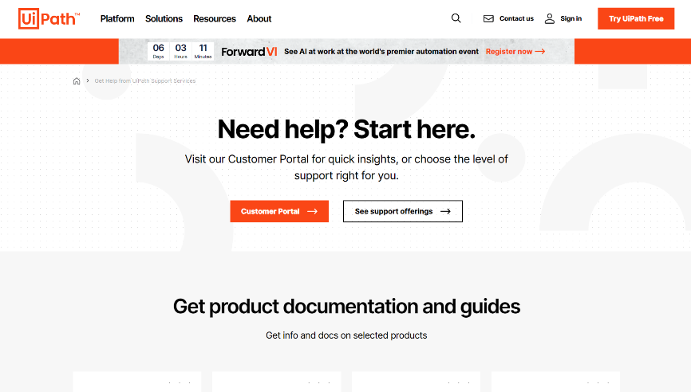
How do I go about this?
To set up an UiPath account, visit https://www.uipath.com/ and click the Try UiPath Free button located at the upper right corner of the page.
Refer to the Configure your first automation_Step-by-Step Instructions PDF file for complete instructions on how to perform the automation.
Notes:
Facilitator notes:
Explain the steps to create a UiPath account. Guide the learners through the steps involved in developing and implementing the automation for the use case using Studio Web. Let the participants know that they can also refer to the Configure your first automation_Step-by-Step Instructions PDF file from their Downloads for complete step-by-step instructions on how to perform the automation. Also, have the participants refer to the Student Guide for more information about the activity.

Slide 40
Congrats on configuring and publishing your first automation! In our next lesson, we'll explore six models of collaboration between humans and robots.
Curious?
Let’s find out!
Notes:
Facilitator notes:
Provide a gist of what will be covered in the next lesson before opening the classroom for discussions.

Slide 41
Discussion
Notes:
Facilitator notes:
Open up the classroom for discussions on what was covered so far. You can also check with the class if they have any questions on what was discussed so far. Use the time to share any relevant work experiences regarding the topic.

Slide 42
04
How do I team up with a robot?

Slide 43
Lesson objectives
At the end of this lesson, you should be able to:
01
Differentiate between multiple scenarios in which a robot and a human can work together.
Notes:
Facilitator notes:
Briefly explain the learning objectives of this lesson.
Detailed notes:
At the end of this lesson, you should be able to:
Differentiate between multiple scenarios in which a robot and a human can work together.

Slide 44

Overview
Let’s meet our range of automation robots and discover how they can collaborate with us to streamline our work processes.
Notes:
Facilitator notes:
Provide a brief introduction of the lesson to the participants.
Detailed notes:
We'd all like to have a helping hand to handle our most tedious tasks, don't we? In this lesson, we'd like to introduce you to that special someone, well, more like a bunch of them. Discover our automation robots and how they can work for you and with you!

Slide 45




How do I work with a robot?
UiPath robots come in more than one flavor.
A robot is a programmable machine that executes automations that
people build.
Attended robots
An automation is a series of steps that tell the robot what to do.
Unattended robots
Notes:
Facilitator notes:
Give a brief introduction about robots to the participants. Also, provide a gist of what unattended and attended robots are.
Detailed notes:
A robot is a robot, right? In some ways, that’s true. In our context, software robots execute automations that people build. An automation is basically a series of steps that tell the robots what to do.
In UiPath, software robots come in more than one flavor. Upcoming unattended and attended robots. Let’s explore them in detail.

Slide 46
Unattended robots
 | Unattended robots: what they are
What they do… | Operate with minimal human intervention Execute fully automated processes
Where they are deployed on… | Workstations Servers, Mainframes Web services
How they are triggered… | Via an automation management tool (UiPath Orchestrator) Based on a set schedule By any activity or event By another robot
Notes:
Facilitator notes:
Briefly explain the concept of unattended robots to the participants.
Detailed notes:
Unattended robots are those that don't need anyone to operate them. Here's a rundown of what unattended robots are all about.
This type of robot operates with minimal human intervention, executing fully automated processes that involve high-volume transactions. It's typically used in task-intensive back-end environments. Unattended robots are deployed on dedicated workstations, servers, mainframes, or web services. Unattended robots are triggered via an automation management tool (UiPath Orchestrator). They are based on a set schedule, by any activity or event, or by another robot.

Slide 47
Attended robots
 | Attended robots: what they are
What they do… | Operate on your computer Become your trusted ally Enhance both quality and productivity Take charge of repetitive tasks Enable you to accelerate processes promptly
Where they are deployed on… | On your PC Laptop Departmental server
How they are triggered… | By the user By certain events on the user's machine
Notes:
Facilitator notes:
Briefly explain the attended robots to the participants.
Detailed notes:
Then there are those robots that need a little help from us humans to work properly. Here’s a rundown of what attended robots are.
This type of robot operates on your computer, becoming your trusted ally, and enhancing both quality and productivity. It takes charge of repetitive tasks, enabling you to accelerate processes promptly. Attended robots are deployed on your PC, laptop, or departmental server. Attended robots can be triggered by the user or by certain events on the user's machine.

Slide 48

Poll time
A company is looking to develop a robot to assist with their onboarding process. The robot's tasks would include:
Entering the employee's information into the company portal
Sending out a welcome email with the login credentials
Creating an HR profile and sharing training materials based on the job profile
Scheduling a meeting for supervisor and employee to review onboarding and answer questions.
Which type of automation is best suited for this use case?
Attended automation
Unattended automation
Notes:
Facilitator notes:
Ask the poll question and encourage participation.
Read each option and ask the participants to raise their hands if they are with the said option.
Ask randomly as to why they feel that they are with the said option.
After the participants get a chance to give their answers, briefly go over the benefits of attended and unattended automation.
Encourage them to ask questions at the end of the session.
The best answer is the attended automation. Also, explain how attended robots can take up the steps in this process.
Provide additional examples when explaining attended and unattended automation in the upcoming slides.

Slide 49
Automation models
There are six automation models tailored to meet a broad spectrum of automation needs.
Model 1: Fully
Unattended
Model 4: Attended,
interval
Model 2: Partially Unattended
Model 5: Attended in tandem
Model 3: Human in
the loop
Model 6: Hybrid automation
Notes:
Facilitator notes:
Explain what automation models are and list the different automation models. Also, briefly explain each model and emphasize its benefits to the participants.
Detailed notes:
Business procedures can differ greatly depending on the industry. Some are straightforward, going from A to B, while others involve multiple interactions between people and systems to move forward. In some cases, a process might need to repeat certain steps to achieve the intended result. Basically, these business processes take time, focus, and energy, as their characteristics and intricacies change from one industry to another.
There are six models tailored to meet a broad spectrum of automation needs, merging the best of user-friendly and business-focused strategies. The models are fully unattended; partially unattended; human in the loop; attended, interval; attended in tandem; and hybrid automation.
Model 1: Fully Unattended
Automation is a game-changer for handling massive amounts of data. Moving and processing data manually across various systems is time-consuming and error-prone. Fully Unattended robots are the perfect solution. They handle data processing without human intervention, ensuring efficiency and accuracy.
Model 2: Partially Unattended
Tired of tedious and repetitive business processes? This automation model offers a solution! Start with human involvement and then hand off the rest to a Partially Unattended robot. This frees you to focus on high-value activities while ensuring the process is completed successfully with thorough documentation and notifications.
Model 3: Human in the loop
Next in the row is the human in the loop automation model. Certain process types requiring intermittent human intervention and complex decision-making can be challenging to automate with traditional tools. However, with this automation model, business rules are embedded into the process, allowing the robot to perform tasks and prompt for input only when necessary, simplifying your role.
Model 4: Attended, interval
In the attended, interval automation model, the attended robot can launch on-demand, run processes from the robot tray, and mimic your actions precisely. The only drawback is that sometimes your machine is occupied during the robot's task. However, you can use the free time for offline tasks.
Model 5: Attended in tandem
Then you have the attended in tandem automation model. In certain situations, it may not be practical or efficient for a robot to take control of your machine. Instead, consider the Attended in Tandem automation model. This approach allows the robot to work alongside you, providing valuable information while you focus on your primary tasks.
Model 6: Hybrid automation
Last in the row is the hybrid automation model. Hybrid automation merges attended and unattended robots within a unified platform. Attended robots assist with customer-facing tasks, while unattended robots handle heavy back-end processing. It automates end-to-end business processes, providing flexibility and scalability.

Slide 50
1. Fully unattended: What it does
In this automation model, the unattended robot:
Launches automatically based on triggers
or schedules.
Is centrally managed by a workflow orchestrator
for 24x7 operation.
Executes the process consistently and alerts
exceptions if any.
Notes:
Facilitator notes:
Provide a brief explanation to the participants on how the fully unattended model operates.
Detailed notes:
The first is the fully unattended model. In this automation model, the unattended robot launches automatically based on triggers or schedules. These robots are centrally managed by a workflow orchestrator for 24x7 operation. It executes the same process consistently and alerts you only when exceptions occur. Also, you play a role in orchestrating the process initially and contributing as needed.

Slide 51


1. Fully unattended: A real-life scenario
Collate all
relevant sales
data from
multiple systems
Aggregate
data
Check data
integrity and
quality. Pass
back exceptions
where required
Verify
data
Create and
send report
Notes:
Facilitator notes:
Present a real-life scenario to the participants. This is just a sample, and you may use any such examples depending on your participants.
Detailed notes:
Let's consider a real-life scenario. A global financial services company needs to collate sales figures from multiple systems, including ERP, CRM, and sales databases, every month. It's a labor-intensive task. Enter Fully Unattended automation! The unattended robot completes the entire process, improving accuracy and timeliness in generating the final report for senior management.

Slide 52
2. Partially unattended: What it does
In this automation model, the partially unattended robot can:
Take over scheduled tasks or upon your instruction.
Handle preparatory work and process initiation.
Program complex business rules.
Provide data validation and assurance.
Notify you only in case of exceptions.
Notes:
Facilitator notes:
Provide a brief explanation to the participants on how the partially unattended model operates.
Detailed notes:
In this automation model, the partially unattended robot can take over scheduled tasks or upon your instruction; handle preparatory work and process initiation; program complex business rules; provide data validation and assurance; and notify you only in case of exceptions.

Slide 53
2. Partially unattended: A real-life scenario
Collate all
relevant
appraisal
information
Trigger
automation
via keystroke
Review
appraisal
Order
appraisal
Gather
appraisal
information
Pass to
advisor
Notes:
Facilitator notes:
Present a real-life scenario to the participants. This is just a sample, and you may use any such examples depending on your participants.
Detailed notes:
Consider a real-life example, mortgage appraisals. Ordering them manually is time-consuming and prone to mistakes. However, with Partially Unattended automation, lenders initiate the process, and the robot takes over. Appraisal time is significantly reduced, leading to cost savings and fewer mortgage escalations.

Slide 54
3. Human in the loop: What it does
In this model, the unattended robot can:
Initiate processes based on schedules or triggers.
Request your input when needed.
Resume the process after you've completed your task.
Repeat this cycle as required within the process.
Notes:
Facilitator notes:
Provide a brief explanation to the participants on how the human in the loop model operates.
Detailed notes:
The unattended robots are deployed in this model. These unattended robots can initiate processes based on schedules or triggers; request your input when needed; resume the process after you've completed your task; and repeat this cycle as required within the process.

Slide 55
3. Human in the loop: A real-life scenario
Scan the
paper-based
invoice
Trigger
automation
via keystroke
Check and
verify data
Trigger
automation
Check data
in the
invoice fields
Pass to ERP
system
Pass poor
quality data
to user
Notes:
Facilitator notes:
Present a real-life scenario to the participants. This is just a sample, and you may use any such examples depending on your participants.
Detailed notes:
Let's take for example an invoice processing use-case. In invoice processing, OCR technology is used to capture information from scanned invoices. However, if the data quality is low, automation alerts you to review and validate the information before entering it into the ERP system. By combining RPA with AI, the system learns from your validations, reducing the need for future intervention.

Slide 56
4. Attended, interval: What it does
In this model, the attended robot can:
Launch on-demand using mouse clicks or hotkeys.
Run the process directly from the UiPath Assistant.
Complete the task in exactly the same way as you would.
Complete the task and return the process to you.
Notes:
Facilitator notes:
Provide a brief explanation to the participants on how the attended, interval model operates.
Detailed notes:
The attended robots are deployed in this model. These attended robots can launch on-demand using mouse clicks or hotkeys; run the process directly from the UiPath Assistant; complete the task in the same way as you would; and complete the task and return the process to you.

Slide 57
4. Attended, interval: A real-life scenario
Trigger
automation
via hot key
Verify data
Trigger
automation
with hot key
Collate all
relevant data
from multiple
sheets
Aggregate
and
manipulate data
Create and
send report
Pass data
back for
verification
Notes:
Facilitator notes:
Present a real-life scenario to the participants. This is just a sample, and you may use any such examples depending on your participants.
Detailed notes:
Let's consider a real-life banking scenario. Debit cards at a bank may be declined for 81 reasons. Smooth customer experience relies on efficient call handling by our staff, explaining the reason. Previously, staff faced a cumbersome process of navigating screens, writing down, and calculating data to provide answers. Now, an attended robot swiftly performs these tasks, instantly presenting employees with a clear description of the declined card's reason.

Slide 58
5. Attended in tandem: What it does
In this model, your attended robot can:
Trigger and execute processes.
Monitor your activities and launch processes automatically.
Run processes directly from the UiPath Assistant (App).
Execute processes while you continue working
on the machine.
Notes:
Facilitator notes:
Provide a brief explanation to the participants on how the attended in tandem model operates.
Detailed notes:
Here again, the attended robots are deployed. These attended robots can trigger and execute processes; monitor your activities and launch processes automatically; run processes directly from the UiPath Assistant (App); and execute processes while you continue working on the machine.

Slide 59
5. Attended in tandem: A real-life scenario
Receive
customer call
Trigger
automation
with hot key
Talk with
customer
Address
query
Resolve issue
and complete
call
Colate all
relevant sales
data from
multiple sheets
Aggregate
and
manipulate data
Pass data
back to
agent
Notes:
Facilitator notes:
Present a real-life scenario to the participants. This is just a sample, and you may use any such examples depending on your participants.
Detailed notes:
In a customer service scenario, agents often face the challenge of navigating multiple systems during customer calls. This process can be time-consuming and prone to errors, leading to frustrations for both the agent and the customer. With Attended in Tandem automation, agents can seamlessly handle customer queries while the robot operates in the background. The robot accesses, compiles, and presents the necessary information, enabling agents to address customer needs more efficiently. This boosts productivity, reduces resolution times, and ultimately enhances customer satisfaction.

Slide 60
6. Hybrid automation: What it does
In the hybrid automation model, you can:
Launch an attended robot from your machine.
Connect attended and unattended robots.
Trigger an unattended robot with an attended robot.
Involve both attended and unattended robots
when further action is needed.
Automate attended and unattended robot collaboration when no human intervention is necessary.
Notes:
Facilitator notes:
Provide a brief explanation to the participants on how the hybrid automation model operates.
Detailed notes:
In the hybrid automation model, you can launch an attended robot from your machine; connect attended and unattended robots; trigger an unattended robot with an attended robot; involve both attended and unattended robots when further action is needed; and automate attended and unattended robot collaboration when no human intervention is necessary.

Slide 61
6. Hybrid automation: A real-life scenario
Trigger
automation
with hot key
Monitor users
actions
Gather
data
Pass data to
unattended
robot
Attended
Automation
Process data
Create and
send
sales report
Unattended Automation
Notes:
Facilitator notes:
Present a real-life scenario to the participants. This is just a sample, and you may use any such examples depending on your participants.
Detailed notes:
Let’s take this example: Sales teams can leverage UiPath's Hybrid automation for improved productivity. Attended automation monitor activities, capturing relevant data. At regular intervals or in real-time, the attended robot transfers information to an unattended robot for further processing and sales report generation.

Slide 62
Playback time!
There are two types of bots:
Attended bots
Unattended bots
Attended bots assist with tedious tasks and speed up processes on a user's computer.
Unattended bots run automated processes with minimal human involvement.
UiPath offers six automation models, varying in human-bot engagement, for various processes and industries.
Notes:
Facilitator notes:
Summarize the points.
Detailed notes:
Recalling the key points!
Attended bots operate on a user's computer, helping them with tedious tasks and speeding up certain processes.
Unattended bots perform fully-automated processes with little to no human interference.
UiPath offers six automation models to accommodate various processes and industries, differing mainly in levels of human-bot engagement.

Slide 63
Check your knowledge
1/2
Which of the following three statements accurately describes the characteristics of attended and unattended automation/robots?
Unattended automation requires little to no human intervention.
Unattended robots handle the routine tasks involved in a process.
In Attended automation, robots work alongside you.
Attended robots handle high-volume transaction-based processes.
Attended robots reside on your PC, laptop, and departmental server.
Unattended robots reside on your PC, laptop, and departmental server.
Notes:
Facilitator notes:
Ask the question and encourage participation.
After the participants get a chance to give their answers, click the slide to reveal the answer.

Slide 64
Check your knowledge
1/2
Which of the following three statements accurately describes the characteristics of attended and unattended automation/robots?
Unattended automation requires little to no human intervention.
Unattended robots handle the routine tasks involved in a process.
In Attended automation, robots work alongside you.
Attended robots handle high-volume transaction-based processes.
Attended robots reside on your PC, laptop, and departmental server.
Unattended robots reside on your PC, laptop, and departmental server.
Notes:
Unattended automation requires little to no human intervention while the robots handle high-volume transaction-based processes. The unattended robots reside on a dedicated workstation, server, mainframe, or web service. In attended automation, robots work alongside you on routine tasks involved in a process. They reside on your PC, laptop, and departmental server.

Slide 65
Check your knowledge
2/2
Match the automation models with their corresponding descriptions.
Human in the Loop
Allowing the robot to handle tasks in the background while the user continues working.
Attended in Tandem
Reducing human input to simple validation, wherever in the process it’s needed.
Fully Unattended
Scheduling the automation platform and allocating the optimal number of robots.
Notes:
Facilitator notes:
Ask the question and encourage participation.
After the participants get a chance to give their answers, click the slide to reveal the answer.

Slide 66
Check your knowledge
2/2
Match the automation models with their corresponding descriptions.
Human in the Loop
Reducing human input to simple validation, wherever in the process it’s needed.
Attended in Tandem
Allowing the robot to handle tasks in the background while the user continues working.
Fully Unattended
Scheduling the automation platform and allocating the optimal number of robots.
Notes:
In an Attended in Tandem model, automation works alongside users, allowing them to work on higher-value tasks while the bot handles repetitive tasks in the background. In a Human in the Loop model, automation encompasses most of the process, while human input is required for specific decision-making or validation steps.
In a Fully Unattended model, the entire process is automated without any human intervention. Robots are scheduled to execute tasks, and the optimal number of robots is allocated to maximize efficiency.

Slide 67
Understanding how you can collaborate with a robot will help you in the long run, when you're ready to submit an automation idea.
Next, see how automation can fit into your business and what roles you can take up as an automation enthusiast.
Notes:
Facilitator notes:
Provide a gist of what will be covered in the next lesson before opening the classroom for discussions.

Slide 68
Discussion
Notes:
Facilitator notes:
Open up the classroom for discussions on what was covered so far. You can also check with the class if they have any questions on what was discussed so far. Use the time to share any relevant work experiences regarding the topic.

Slide 69
05
How can automation fit into my business?

Slide 70
Lesson objectives
At the end of this lesson, you should be able to:
01
Recognize the roles that were created to support the automation journey.
02
Identify which roles you can take in the automated enterprise context.
Notes:
Facilitator notes:
Briefly explain the learning objectives of this lesson.
Detailed notes:
At the end of this lesson, you should be able to:
Recognize the roles that were created to support the automation journey.
Identify which roles you can take in the automated enterprise context.

Slide 71
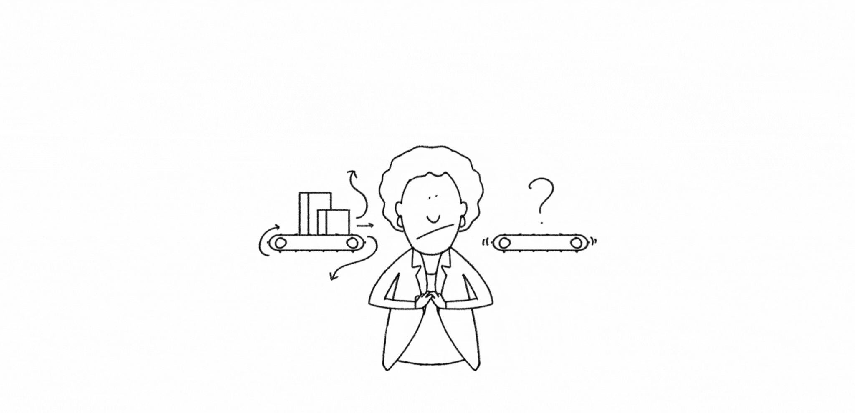
Should you be worried? Not really…
Notes:
Facilitator notes:
Provide an introduction to the participants on the changes that can happen in their organization when it adopts automation and how they can benefit from it. Inform the participants that it is not uncommon to be anxious about their organization embracing new technology.

Slide 72

How can I benefit from my organization embracing automation?
Automation:
Creates opportunities to advance skills and achieve greater success.
Provides new job opportunities, roles, and various upskilling possibilities.
Notes:
Facilitator notes:
Provide a brief introduction of the changes that can happen when an organization embraces automation. Focus on the roles that will be created when an organization jumps on the automation bandwagon.
Detailed notes:
Software robot will replace some jobs, but automation also creates opportunities to advance skills and achieve greater success. Let’s look at organizational changes during automation journeys, exploring newly-created jobs, roles, and upskilling possibilities that come with the process.

Slide 73

Different roles that automation can create
Notes:
Facilitator notes:
Give an overview of how automation is changing the way many businesses work, allowing them to make processes more efficient and free up resources. List a few of the roles that automation can create in a company. Ask the participants to refer to the Role-based Journeys zip file to learn more about role-based journeys.

Slide 74
Playback time!
Automation:
Opens opportunities for skill advancement
Yields new roles and opportunities
Promotes career development
Inspires employees to expand their skills
Notes:
Facilitator notes:
Summarize the points.
Detailed notes:
Recalling the key points!
Contrary to common misconceptions, automation and digital transformation open up opportunities for skill advancement and career success.
As automation is integrated throughout the organization, new roles and possibilities emerge, fostering professional growth and encouraging employees to expand their expertise.

Slide 75
Check your knowledge
1/1
When an organization is in the initial stages of its automation journey, who raises automation requests?
Automation Users
Business
The Automation CoE
Senior Management
Notes:
Facilitator notes:
Ask the question and encourage participation.
After the participants get a chance to give their answers, click the slide to reveal the answer.

Slide 76
Check your knowledge
1/1
When an organization is in the initial stages of its automation journey, who raises automation requests?
Automation Users
Business
The Automation CoE
Senior Management
Notes:
In the initial stages of an organization's automation journey, the Automation Center of Excellence (CoE) typically raises automation requests. This is because the Automation CoE is responsible for overseeing the organization's automation strategy, including identifying, prioritizing, and implementing automation opportunities. It ensures that the right processes are selected for automation, in line with the organization's objectives and goals, while also maintaining standards and best practices.

Slide 77
Discussion
Notes:
Facilitator notes:
Open up the classroom for discussions on what was covered so far. You can also check with the class if they have any questions on what was discussed so far. Use the time to share any relevant work experiences regarding the topic.

Slide 78
With a better understanding of automation's potential, prepare for the upcoming lesson, where we'll focus on pinpointing some automation opportunities.
Stay tuned!
Notes:
Facilitator notes:
Provide a gist of what will be covered in the next lesson before opening the classroom for discussions.

Slide 79
06
How do I identify automation opportunities?

Slide 80
Lesson objectives
At the end of this lesson, you should be able to:
01
Identify key properties of tasks or processes that can be automated.
02
Recognize 1–3 tasks or processes that can be automated from your day-to-day work.
Notes:
Facilitator notes:
Briefly explain the learning objectives of this lesson.
Detailed notes:
At the end of this lesson, you should be able to:
Identify key properties of tasks or processes that can be automated.
Recognize 1–3 tasks or processes that can be automated from your day-to-day work.

Slide 81
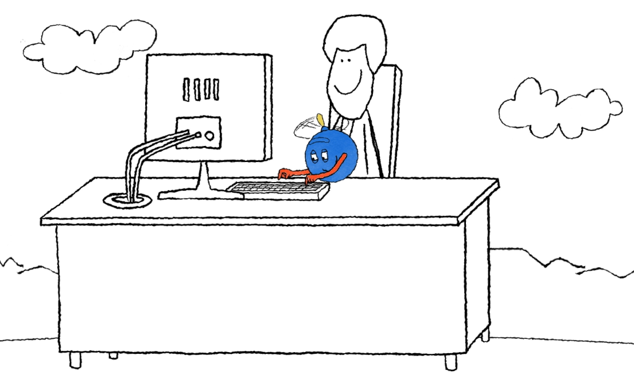
Overview
How do I determine the opportunities and their feasibility?
Which tasks can be automated?
Notes:
Facilitator notes:
Provide a brief introduction of the lesson to the participants.
Detailed notes:
By now, you should understand that automating tedious, repetitive tasks frees up your time. However, you might wonder which tasks can be automated, their feasibility, and how to determine that. To help answer these questions, we've created a Process Assessment tool that guides you on the right path to building or submitting automation ideas.

Slide 82
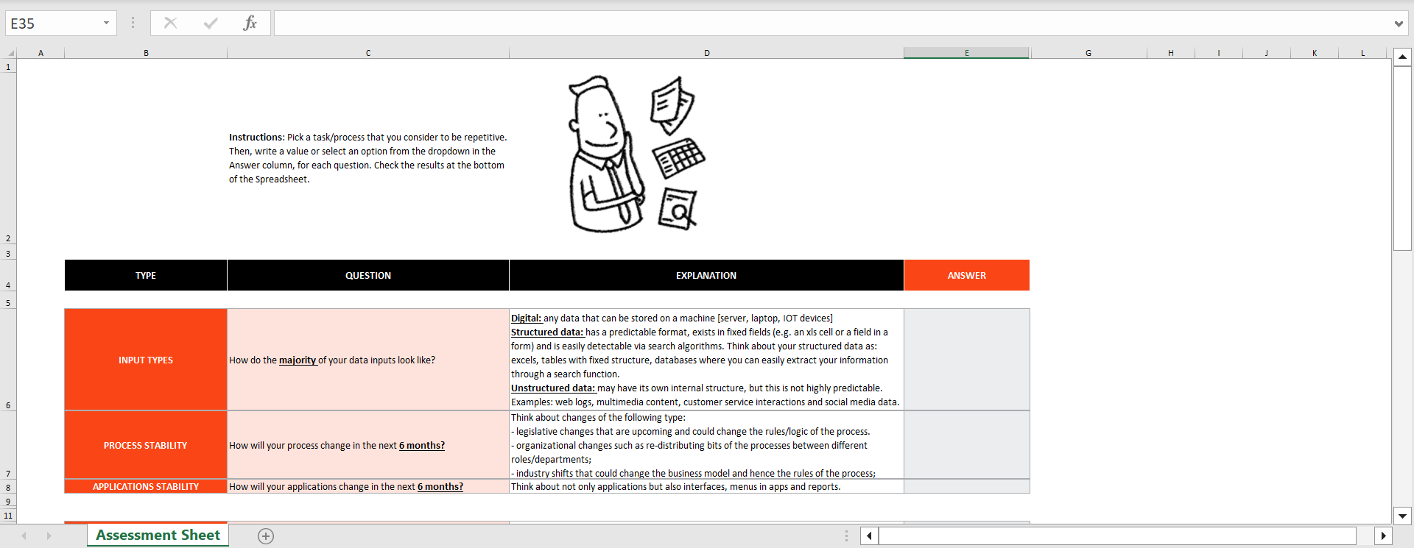
The process assessment tool
The Process Assessment tool is super helpful for figuring out if automating a process is feasible.
Notes:
Facilitator notes:
Display the Process Assessment Tool and explain its purpose in calculating a process’s feasibility for automation.
Detailed notes:
The Process Assessment Tool is here to help you determine if your automation idea is a good fit for automation and to evaluate its feasibility. This tool comes with a set of questions regarding the process's characteristics and its current state. Your answers to these questions shape the outcome.
The result highlights the benefits of automating the specific process, the simplicity of its implementation, and development, and the hours you could save.

Slide 83
Example 1: Invoice processing
01
Receive
invoices
via email
02
Download
all the attachments
03
Check for discounts on the portal
04
Save as
PDFs and
email
Notes:
Facilitator notes:
Take up the "Invoice Processing" use case and explain the steps involved in the current process. Then, populate the Process Assessment tool template based on the process and arrive at the automation score. Explain what the score indicates and what your next steps can be.
Detailed notes:
Taylor is an accountant. One of their major tasks is processing invoices. This task is manual and time-consuming. Taylor’s company is planning to take this task as a pilot as they are getting started on their automation journey.
The steps involved in the process are as follows:
Receive invoices via email
Download all the attachments
Check for discounts on the portal
Save as PDFs and email
Based on these details, go through each question listed in the Process Assessment tool and provide the responses that align with the use case. Explain the automation score to the participants.

Slide 84
Example 2: Assessing and approving commercial loans
01
Submit the loan application
02
Initiate the initial screening
03
Review the financial status
04
Access the risk involved
05
Provide the preliminary approval
10
Monitor the loan performance
09
Disburse the funds
08
Provide the final approval
07
Review the overall risk exposure
06
Perform the internal review
Notes:
Facilitator notes:
Take up the "Assessing and Approving Commercial Loans" use case and explain the steps. In this instance, as you perform the steps and populate the Process Assessment tool, encourage inputs from the participants. When you arrive at the score, encourage the class to explain what the automation score indicates and what the next steps can be.
Detailed notes:
You've got the hang of how the Process Assessment tool works, right? To deepen your understanding, we have another example for you. Taylor's boss has now asked them to evaluate the commercial loan application process for a banking client. In this use case, we'll analyze a commercial loan application process. Let's see what the tool reveals about this one.
The steps involved in the process:
Submit the loan application
Initiate the initial screening
Review the financial status
Access the risk involved
Provide the preliminary approval
Perform the internal review
Review the overall risk exposure
Provide the final approval
Disburse the funds
Monitor the loan performance
Analyze the process and proceed with populating the tool. Find out the automation score for this process and what the results mean.

Slide 85





It's your turn now!
To complete your assessment, follow these steps.
1. Open the Process Assessment Tool document.
2. Read the use case in the student guide carefully.
3. Fill in your answers in the Process Assessment tool.
4. Check out the Automation Score based on the process complexity, benefits of automation, and ease of implementation!
Notes:
Facilitator notes:
For this exercise, request the participants to open the Process Assessment tool that they have from the downloaded documents. When the participants are ready, request them to refer to the Student Guide for the use case. Allow them 10 minutes to go through the use case. At the end of 10 minutes, encourage the participants to perform the exercise on their own. Give them another 10 mins to work on it and encourage them to share their answers with you. You may also share your version of the completed exercise with the participants.
Detailed notes:
Use the Process Assessment tool on Jamie's use case to evaluate the automation potential of their process.
First things first, here are the steps you need to take to complete your assessment:
Download the Process Assessment Tool document. If you aren't a Microsoft Office user, you can convert it to a format that fits your environment (e.g., upload it to your Google Drive and convert it to a Google Sheets document).
Read the use case in the student guide carefully. It's important to have the use case figured out from the beginning to have a clear picture of what you're working with. Feel free to take notes on the steps of the process (here, we're lending you a hand!) and other details you find noteworthy.
Fill in your answers in the Process Assessment tool. As you've seen in the videos, there's a dedicated column where you can fill in the answers to the questions in the Process Assessment tool. With this step, you'll showcase if and how much the use case meets the set automation criteria. For some of the criteria, you can consult the useful tips in the "Explanation" column. It's also important to note that, depending on each assessor's perspective on the use case, the solution may slightly vary. Try to be as thorough as possible and take into account the small details, like sub-steps that may be involved.
Check out the Automation Score based on the process complexity, benefits of automation, and ease of implementation! At the end of the document, after filling in your answers, you'll see the evaluation results. Check yours against the question at the end of this lesson and, if you're curious, against our version of it.

Slide 86
Playback time!
The Process Assessment tool simplifies process automation evaluation with a set of questions and a scoring system.
The assessment result highlights:
Benefits
Suitability
Ease of development
Annual liberated man-hours
Estimated error reduction percentage
Notes:
Facilitator notes:
Summarize the points.
Detailed notes:
Recalling the key points!
The Process Assessment tool makes it easy to determine which processes can be automated by asking a series of questions and calculating a score.
The assessment result highlights benefits, suitability, ease of development, annual liberated man-hours, and the estimated error reduction percentage during automation.

Slide 87
Knowing this, are you eager to determine the first processes to automate within your organization?
...And now that you've learned how to identify automation opportunities, it's time for the final knowledge check before completing the course!
Notes:
Facilitator notes:
Provide a gist of what will be covered in the next lesson before opening the classroom for discussions.

Slide 88
Discussion
Notes:
Facilitator notes:
Open up the classroom for discussions on what was covered so far. You can also check with the class if they have any questions on what was discussed so far. Use the time to share any relevant work experiences regarding the topic.

Slide 89
Let’s put your knowledge to the test!
Notes:
Facilitator notes:
There will be 10 questions in this section.
Ask each question and encourage participation.
After the participants get a chance to give their answers, click the slide to reveal the answer.

Slide 90
Check your knowledge
1/10
What role did Arden play in XYZ Inc.'s Change Management department after becoming an Automation Champion?
Building software robots.
Encouraging and supporting the adoption of automation.
Implementing automation projects.
Conducting Process Mining analysis.

Slide 91
Check your knowledge
1/10
What role did Arden play in XYZ Inc.'s Change Management department after becoming an Automation Champion?
Building software robots.
Encouraging and supporting the adoption of automation.
Implementing automation projects.
Conducting Process Mining analysis.
Notes:
As an Automation Champion, Arden's role was to encourage and support his colleagues in the adoption of automation within the department. By sharing his experiences and helping others embrace the benefits of automation, Arden played an essential part in fostering an automation-centric mindset and furthering the success of automation initiatives within the organization.

Slide 92
Check your knowledge
2/10
A customer service agent needs real-time assistance with accessing and presenting necessary information while handling a customer call. Which automation model is best suited for this situation?
Attended in tandem
Fully unattended.
Human in the loop
Partially unattended

Slide 93
Check your knowledge
2/10
A customer service agent needs real-time assistance with accessing and presenting necessary information while handling a customer call. Which automation model is best suited for this situation?
Attended in tandem
Fully unattended.
Human in the loop
Partially unattended
Notes:
Attended in Tandem model supports users in real-time while they perform their tasks. In the given scenario, the customer service agent requires support in accessing and presenting data during a customer call. With an attended robot operating in tandem, the robot seamlessly works in the background, gathering and presenting the necessary information to the agent while the agent focuses on addressing the customer needs.

Slide 94
Check your knowledge
3/10
Per the scenario presented in the course, which four of the following steps are part of the process of setting up an automation in Studio Web?
Configure your connections.
Publish the automation.
Test the automation by running it.
Obtain peer approval before running the automation.
Select a template.
Set a password before running the automation.

Slide 95
Check your knowledge
3/10
Per the scenario presented in the course, which four of the following steps are part of the process of setting up an automation in Studio Web?
Configure your connections.
Publish the automation.
Test the automation by running it.
Obtain peer approval before running the automation.
Select a template.
Set a password before running the automation.
Notes:
In the given scenario, the automation requires connections to Google Drive, Google Sheets, and Gmail, which are external third-party services. Installing a browser extension allows UiPath to communicate and work efficiently within browser tabs. The automation sends an email as part of the overall process. Configuring the email address is necessary to ensure the automation can access and use the correct account for sending emails. Once the automation is set up and tested, publishing it helps make it easily accessible for future use. You can run it anytime you want; it doesn't require setting up a password or any peer approval.

Slide 96
Check your knowledge
4/10
In a fully unattended automation scenario, what is the primary characteristic of the unattended robot?
It operates without human intervention.
It has limited capabilities in handling multiple systems.
It needs regular input from users.
It only works during business hours.
It requires constant human supervision.

Slide 97
Check your knowledge
4/10
In a fully unattended automation scenario, what is the primary characteristic of the unattended robot?
It operates without human intervention.
It has limited capabilities in handling multiple systems.
It needs regular input from users.
It only works during business hours.
It requires constant human supervision.
Notes:
Fully unattended robots are designed to autonomously perform tasks within an automation process. For example, in the global financial services company scenario, the unattended robot completes the entire data collation process from multiple systems utilizing its pre-programmed instructions. It executes the process consistently and efficiently, freeing up human resources for more value-added tasks and minimizing the risk of manual errors. The robot alerts humans only when exceptions occur, thereby demonstrating its ability to operate without the need for constant human supervision or intervention.

Slide 98
Check your knowledge
5/10
In the Invoice Process scenario, how does the Process Assessment tool determine if Taylor's invoice processing task is a good candidate for automation?
The tool relies solely on structured input data percentage.
The tool checks the total number of transactions per day.
The tool focuses on the number of virtual machines used in the process.
The tool calculates an automation score considering benefits, ease of implementation, and potential error reduction.
The tool evaluates the process based on its complexity..

Slide 99
Check your knowledge
5/10
In the Invoice Process scenario, how does the Process Assessment tool determine if Taylor's invoice processing task is a good candidate for automation?
The tool relies solely on structured input data percentage.
The tool checks the total number of transactions per day.
The tool focuses on the number of virtual machines used in the process.
The tool calculates an automation score considering benefits, ease of implementation, and potential error reduction.
The tool evaluates the process based on its complexity..
Notes:
The Process Assessment takes into account factors such as the benefits of automation (e.g., time savings, error reduction), the ease of development and implementation, and how much the process is expected to change.
By analyzing these factors and calculating an automation score, the Process Assessment tool provides a comprehensive assessment of the feasibility and potential impact of automation. This helps Taylor and the company make informed decisions about whether to proceed with automating the invoice processing task and how it might benefit employees and the organization.

Slide 100
Check your knowledge
6/10
What types of robots are involved in hybrid automation?
Unattended robots only.
Attended robots only.
Attended and unattended robots.

Slide 101
Check your knowledge
6/10
What types of robots are involved in hybrid automation?
Unattended robots only.
Attended robots only.
Attended and unattended robots.
Notes:
Hybrid automation refers to a combination of both attended and unattended robots working together within a unified platform. In this approach, attended robots typically assist with user-facing tasks, while unattended robots focus on handling heavy back-end processing. By combining the capabilities of both robot types, hybrid automation can automate end-to-end business processes more effectively.

Slide 102
Check your knowledge
7/10
What is the main goal of automation?
To demand more human intervention in business processes.
To make increase task/process complexity.
To boost efficiency, accuracy, and productivity.
To replace humans in all of the work they have to do.

Slide 103
Check your knowledge
7/10
What is the main goal of automation?
To demand more human intervention in business processes.
To make increase task/process complexity.
To boost efficiency, accuracy, and productivity.
To replace humans in all of the work they have to do.
Notes:
The primary objective of automation is to improve work processes by reducing the need for manual labor, especially for repetitive tasks. This leads to increased efficiency, as tasks can be performed more quickly and accurately by automation tools. Nevertheless, let's not forget that robots, while they mimic human behavior, aren't capable of everything we, humans, are.

Slide 104
Check your knowledge
8/10
What are two main advantages that automation brings?
It identifies and fixes vulnerabilities in company processes.
It reduces errors for better data quality and improves compliance.
It helps streamline standardized processes and increases scalability.
It makes decisions on its own, autonomously, and independently from any human input.
It increases the workload of human employees.

Slide 105
Check your knowledge
8/10
What are two main advantages that automation brings?
It identifies and fixes vulnerabilities in company processes.
It reduces errors for better data quality and improves compliance.
It helps streamline standardized processes and increases scalability.
It makes decisions on its own, autonomously, and independently from any human input.
It increases the workload of human employees.
Notes:
Automation streamlines business processes through software robots, which execute tasks efficiently and consistently. This leads to improved process management and operational efficiency. By automating tasks, businesses minimize human error, enhance data quality, and free up employees of repetitive work. However, robots are not humans. They execute automation workflows with clear instructions, built by humans. They cannot make decisions independently, outside of their instructions' scope.

Slide 106
Check your knowledge
9/10
Why is it necessary to establish third-party connections for some automations in UiPath Studio Web?
To allow the automation to run faster and more efficiently.
To facilitate automatic updates to the automation workflow.
To ensure secure storage of sensitive information within the project files.
To enable the automation to access and interact with external services (such as the Google Workspace applications).

Slide 107
Check your knowledge
9/10
Why is it necessary to establish third-party connections for some automations in UiPath Studio Web?
To allow the automation to run faster and more efficiently.
To facilitate automatic updates to the automation workflow.
To ensure secure storage of sensitive information within the project files.
To enable the automation to access and interact with external services (such as the Google Workspace applications).
Notes:
By establishing connections with these third-party services, the automation can perform the intended tasks accurately, which is essential for a successful automation run. These connections enable the automation to perform tasks across multiple applications, facilitating seamless data exchange and process execution between different platforms.

Slide 108
Check your knowledge
10/10
In what two ways should a task or process be like to be automatable?
With a high degree of complexity, involving multiple decision-makers.
Requiring creative problem solving.
Constantly changing.
Repetitive and predictable.
Rule-based.

Slide 109
Check your knowledge
10/10
In what two ways should a task or process be like to be automatable?
With a high degree of complexity, involving multiple decision-makers.
Requiring creative problem solving.
Constantly changing.
Repetitive and predictable.
Rule-based..
Notes:
Tasks and processes requiring complex decision-making and creativity, with a high degree of unpredictability or that are constantly evolving, are best suited for people to handle. The robots are able to pick up whatever tedious, repetitive work remains! They aren't capable of "thinking" on their own, so judgment calls or working in an unknown scenario are out of the question.

Slide 110
Discussion
Notes:
Facilitator notes:
Open up the classroom for discussions on what was covered so far. You can also check with the class if they have any questions on what was discussed so far. Use the time to share any relevant work experiences regarding the topic.

Slide 111
We’d love to read your feedback!
Open the form
Notes:
We hope you found the materials insightful and that they added great value to your session. As part of our commitment to continuous improvement and since we provide these resources for free, we have a small favor to ask: spend a few minutes filling in the feedback form at the end of the presentation deck.
Your insights and experiences are incredibly valuable to us. They help us fine-tune our materials and ensure they remain top-notch for future trainers like you.

